Slide 1



Operating System Workshop
Organized by: SES
Lead of Work Dev: M Mati Ur Rehman

Slide 2
List Of Content
Operating System Overview
Process Creation
Inter Process Communication
Scheduling Algorithms and Purpose
Threads
Synchronization & Buffering
Semaphores & Mutex
Practice Coding Questions
Review Code & Past Papers

Slide 3
OS Overview
Backbone Of Computer Science
Manage Hardware and Software resources
Critical for optimizing performance and solving problems
Enhances understanding of how devices and applications interact

Slide 4
Real Life Examples
Resource Management (Multitasking)
Networking
Cloud Computing and Virtualization
Software Development and Optimization

Slide 5

Process Creation
Process creation is a fundamental concept in operating systems, where a program in execution is referred to as a process. Each process has its own resources (e.g., CPU, memory) and executes independently.
When you run a program (e.g., opening a web browser or launching a game), the operating system creates a process for that program.

Slide 6
Why do we use Process Creation
Multitasking: Allows multiple programs to run concurrently (e.g., browsing the web while listening to music).
Resource Management: Each process gets its own memory and CPU resources to prevent conflicts and crashes.
Security and Isolation: Processes are isolated from each other, preventing malicious programs from affecting others.
Scheduling: Allows the OS to manage how different processes share CPU time effectively.

Slide 7
Where is it used? Real Life example’s
Web Browsers (e.g., Google Chrome)
Video Games
Server Applications (e.g., Web Servers)
Operating System Services (e.g., File Explorer in Windows)
Mobile Applications

Slide 8
Key Benefits
Concurrency: Run multiple tasks at once (e.g., checking emails while writing a document).
Fault Isolation: One process crash doesn't bring down the whole system.
Efficient Resource Allocation: Dynamically assigns CPU, memory, and other resources.
Enhanced Security: Processes are sandboxed to prevent unauthorized access.

Slide 9
Steps Involved in Process Creation
Parent Process Requests Creation
1
Resource Allocation
2
Process Control Block (PCB) Setup
3
Process Inheritance
4
Process Initialization
5
Process Execution
6
Process Termination
7

Slide 10
Important System Calls
fork()
exec()
wait()
exit()

Slide 11
Defunct Processes
Zombie Process
Completed execution but remains in the process table.
Occupies no resources other than its process entry.
Parent Process must call wait() to remove it.
Too many zombies can exhaust system process slots.
Orphan Process:
Parent process has terminated, but the child is still running.
Automatically adopted by the init process in Unix/Linux systems.
Continues executing normally without a parent.
Does not negatively affect system performance.

Slide 12
Context Switching
Context switching is when the operating system pauses one process and switches to another, saving the state of the first process so it can resume later
Examples:
Multitasking on your computer.
Handling multiple apps on a smartphone

Slide 13

Process Creation Coding Example’s

Slide 14
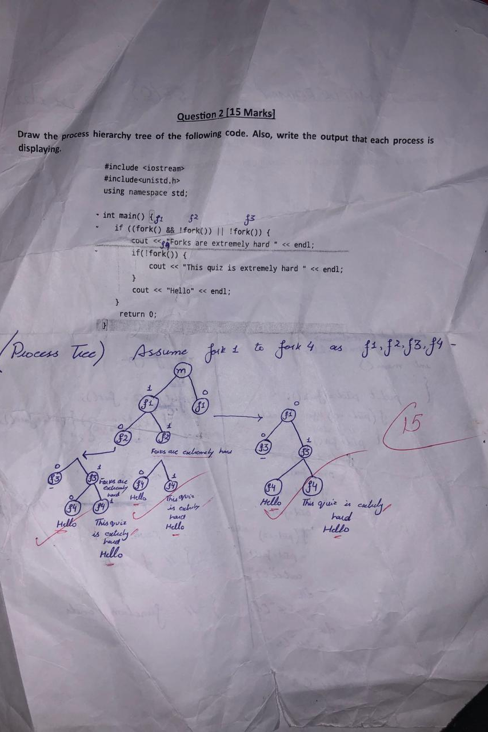
Fork Tree Example
Fork Tree Example

Slide 15
Inter Process Communication

Slide 16
IPC Communication Models
Shared Memory
Multiple processes share a common memory space to read and write data
Real life Example:
Think of shared memory like a whiteboard where different people (processes) write and read information. Everyone can access the board, but they must coordinate to avoid overwriting each other's work.
Message passing
Processes exchange information by sending messages to each other without sharing the same memory space
Real Life example:
It's like sending letters. One person (process) writes a message and sends it to another person, who reads it. The communication happens through the message exchange, not by sharing space.

Slide 17
Pipes Creation
Unnamed Pipes
Named Pipes
Used for communication between related processes (usually a parent and child). They exist only while the processes are running.
Creation using Pipe system call
Example:
Parent child communication
Used for communication between any processes, whether they are related or not. They have a name and exist as files in the filesystem.
Creation using mkfifo() system call.
Example:
Chat Application Communication

Slide 18
IPC Coding Question’s

Slide 19
Scheduling

Slide 20
Why Do We Need Scheduling?
Resource Management: Efficiently allocates CPU time and other resources to processes, ensuring that the system operates smoothly.
Responsiveness: Enhances the responsiveness of applications by prioritizing processes based on their needs.
Fairness: Ensures that all processes get a fair share of CPU time, preventing any single process from monopolizing the CPU.
Maximizing Throughput: Increases the number of processes completed in a given time frame, improving overall system performance.

Slide 21
Advantages of Process Scheduling:
Improved CPU Utilization: Scheduling allows the CPU to remain busy with active processes, reducing idle time.
Enhanced System Performance: Efficient scheduling algorithms can lead to quicker task completion and better system throughput.
Fair Resource Distribution: Ensures that all processes, including background tasks and user applications, get a fair share of CPU time.

Slide 22
Real Life example’s
Multi-tasking Operating Systems
Cloud Computing Services:
Real-Time Systems:

Slide 23

Scheduling Algorithm’s
FiFO
Robin
SJF
SRTF

Slide 24
Threads

Slide 25
Why Do We Use Threads?
Concurrency: Threads allow multiple tasks to run simultaneously within a single application, making better use of CPU resources.
Responsiveness: By using threads, applications can remain responsive to user input while performing background tasks (e.g., loading data).
Resource Sharing: Threads within the same process share resources (like memory), which makes inter-thread communication more efficient than inter-process communication.

Slide 26
Real-Life Examples of Threads:
Web Browsers.
Multimedia Applications.
Game Development.

Slide 27
Play with Threads

Slide 28
Mechanisms
Synchronization
Buffering
Synchronization is the coordination of concurrent processes or threads to ensure that they access shared resources safely and in a controlled manner, preventing conflicts and ensuring data consistency.
Example:
Using a lock or mutex to ensure that only one thread can update a shared bank account balance at a time, preventing race conditions.
Buffering is the temporary storage of data in a memory area (buffer) while it is being transferred between two places, helping to manage differences in data processing rates.
Example:
In video streaming, data is buffered to allow for smooth playback, so the video continues to play even if there are brief delays in downloading the content from the internet.

Slide 29
Synchronization Primitives
Semaphores
Mutex
A synchronization primitive that uses a counter to control access to a shared resource. Semaphores can allow multiple threads to access the resource simultaneously, depending on the counter value.
Example:
Traffic Light System.
Thread Pool.
A synchronization primitive that allows only one thread to access a shared resource at a time. Mutexes are used to ensure exclusive access to prevent race conditions.
Example:
Bank Account Balance Update.
File Writing.

Slide 30
Coding Question’s

Slide 31
GCR Code: ja25rmy Use Personal Emails Link: https://classroom.google.com/c/NzE0MTI1OTMyMzc4?cjc=ja25rmy

Slide 32

Thank You

